Slide 1
ECE 333 Green Energy Systems
Lecture 8: The Solar Resource
Dr. Karl Reinhard
Dept. of Electrical and Computer Engineering
University of Illinois at Urbana-Champaign
reinhrd2@illinois.edu

Slide 2
Announcements
Start reading
Chapter 4 (The Solar Resource) and
Chapter 5 (Photovoltaic Materials & Electrical Characteristics)
Quiz 3 today
Homework 4 posted
Power & Energy Conference at Illinois (PECI) 2018
22-23 Feb 2018, I-Hotel
Free; Registration Reqd NLT; Great Food !! Great Speakers
GREAT NETWORKING OPPORTUNITY!!

Slide 3
PECI 2018

Slide 4
Additional UIUC ECE Power Classes
If you are interested in going further with electric energy systems the following classes will be of interest
ECE 330: Power Circuits and Electromechanics (every semester and summer)
ECE 476: Power System Analysis; prerequisite is ECE 330 (but you would be OK with 333 and concurrent enrollment in 330)
ECE 464/469: Power Electronics (fall only); prerequisite is ECE 342
ECE 431: Electric Machinery (spring only); prerequisite is ECE 330
Grainger Award -- $6000
To reward highly qualified and well-motivated undergraduate and graduate students who have chosen to pursue a field of study in electric power engineering.
https://ece.illinois.edu/academics/ugrad/scholarships-and-awards/awards/grainger

Slide 5
The Solar Resource
Before we can talk about solar power, we need to talk about the sun
Need to know how much sunlight is available
Can predict where the sun is at any time
Insolation : incident solar radiation
Want to determine the average daily insolation at the solar system installation site
Must choose effective locations and panel tilts of solar panels
Notes:
4

Slide 6
The Sun and Blackbody Radiation
The Sun
1.4 million km in diameter
3.8 x 10²⁰ MW of radiated electromagnetic energy
Black bodies
Both a perfect emitter and a perfect absorber
Perfect emitter – radiates more energy per unit of surface area than a real object of the same temperature
Perfect absorber – absorbs all radiation, none is reflected
Temperature in Kelvin is temperature in Celsius + 273.16
Notes:
5

Slide 7
Plank’s Law
Plank’s law – wavelengths emitted by a blackbody depend on temperature
λ = wavelength (μm)
E_{λ} = emissive power per unit area of black body (W/m²-μm)
T = absolute temperature (K)
Notes:
6

Slide 8
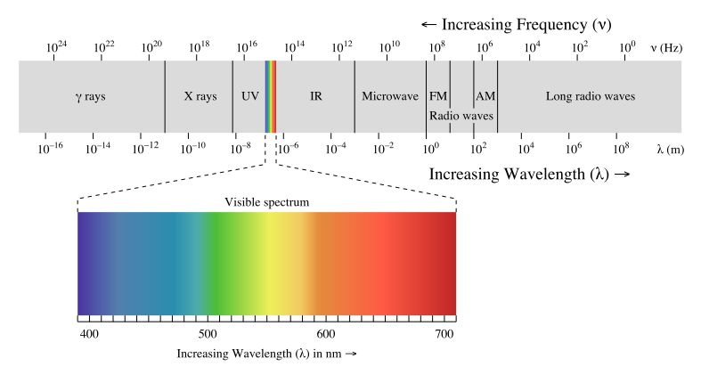
Electromagnetic Spectrum
Visible light has a wavelength of between 0.4 and 0.7 μm, with ultraviolet values immediately shorter, and infrared immediately longer
Source: en.wikipedia.org/wiki/Electromagnetic_radiation

Slide 9
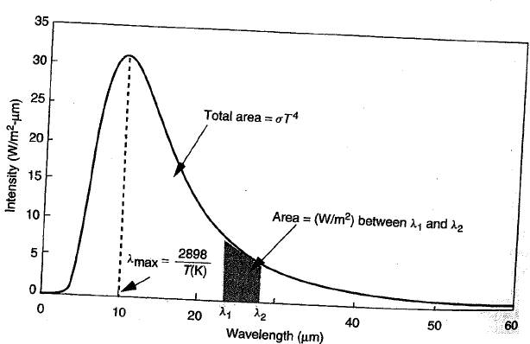
288 K Blackbody Spectrum
The earth as a black body; note 0.7 μm is red. Most all is infrared range, which is why the earth doesn’t glow!
Figure 7.1
Area under curve is the total radiant power emitted
Notes:
8

Slide 10
Stefan-Boltzmann Law
Total radiant power emitted is given by the Stefan –Boltzmann law of radiation
E = total blackbody emission rate (W)
σ = Stefan-Boltzmann constant = 5.67x10⁻⁸ W/m²-K⁴
T = absolute temperature (K)
A = surface area of blackbody (m²)
Notes:
9

Slide 11
Wien’s Displacement Rule
The wavelength at which the emissive power per unit area reaches its maximum point
Notes:
10

Slide 12
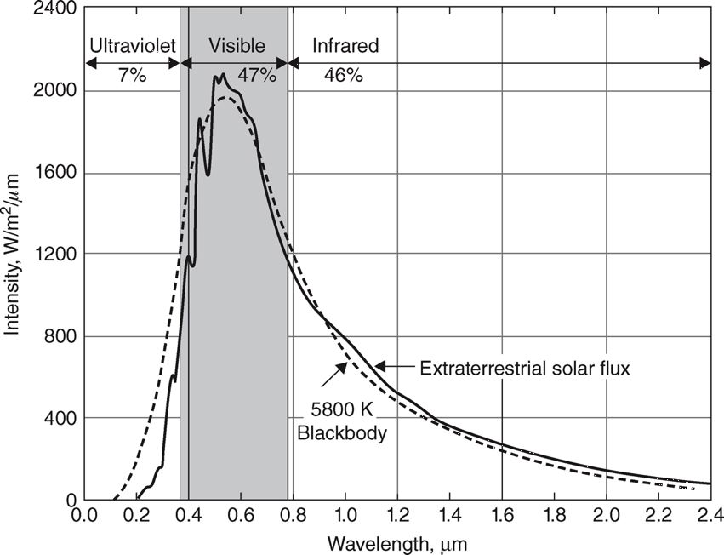
Extraterrestrial Solar Spectrum
FIGURE 4.2 The extraterrestrial solar spectrum compared with a 5800 K blackbody.
Masters, Gilbert M. Renewable and Efficient Electric Power Systems, 2nd Edition. Wiley-Blackwell

Slide 13
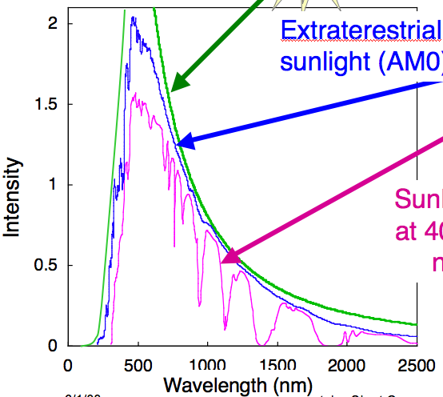
Solar Intensity: Atmospheric Effects
Sun photosphere
Extraterrestrial sunlight (AM0)
Intensity
Sunlight at sea level at 40° N Latitude at noon (AM1.5)
“AM” means “air mass”
Notes:
12

Slide 14
Air Mass Ratio
FIGURE 4.3
The air mass ratio m is a measure of the amount of atmosphere the sun's rays must pass through to reach the earth's surface.
Masters, Gilbert M. Renewable and Efficient Electric Power Systems, 2nd Edition. Wiley-Blackwell
As sunlight transits the atmosphere, energy is absorbed
AM1.5 – assumed earth’s surface average
Air mass ratio = 1 (“AM1”) – sun directly overhead
AM0 – no atmosphere
Notes:
13

Slide 15
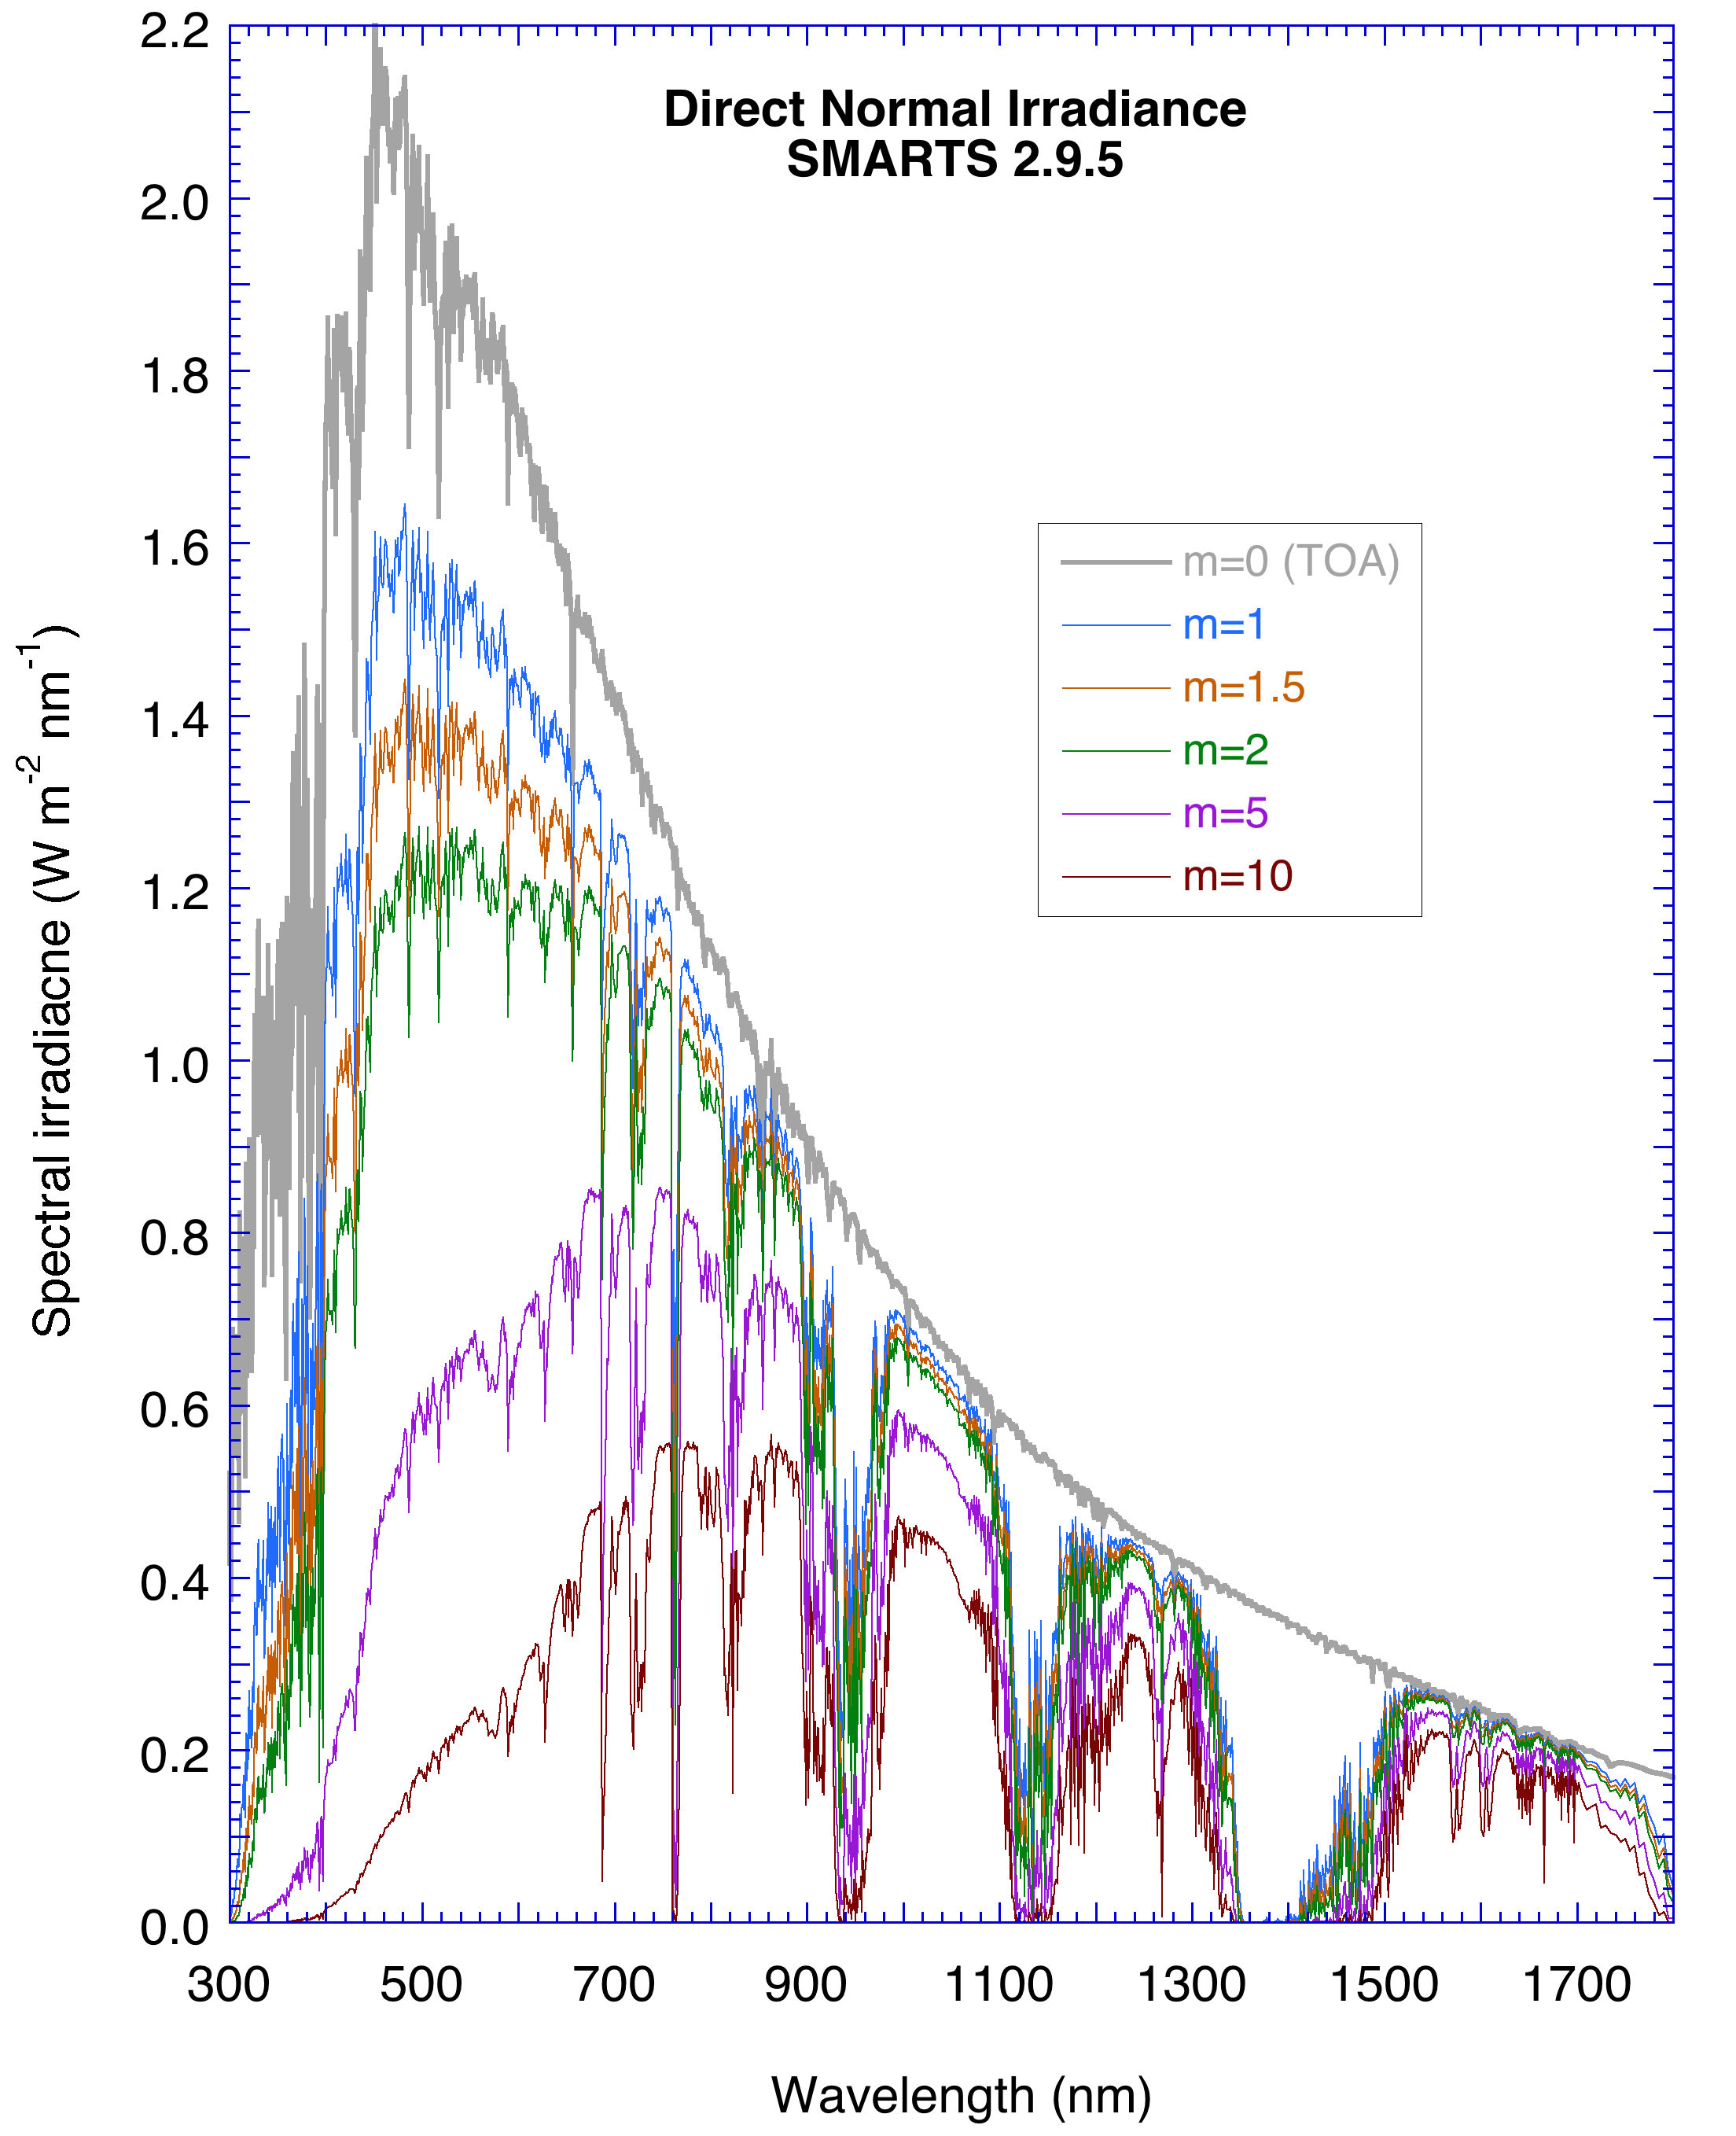
Solar Spectrum on Earth’s Surface
m is higher when the sun is closer to the horizon
Notice blue light attenuation with higher m,
→ sun appears reddish at sunrise and sunset
C.A. Gueymard, The sun’s total and spectral irradiance for solar energy applications and solar radiation models. Solar Energy, vol. 76, 423-453 (2004)
https://en.wikipedia.org/wiki/Simple_Model_of_the_Atmospheric_Radiative_Transfer_of_Sunshine_(SMARTS)#cite_ref-1
Blue is 450 nm, Red is 700 nm

Slide 16
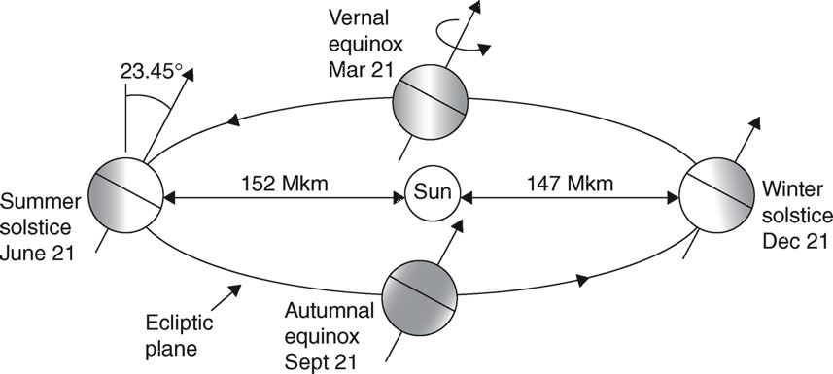
The Earth’s Orbit
FIGURE 4.5 The tilt of the earth's spin axis with respect to the ecliptic plane is what causes our seasons. “Winter” and “Summer” are designations for the solstices in the Northern Hemisphere.
Masters, Gilbert M. Renewable and Efficient Electric Power Systems, 2nd Edition. Wiley-Blackwell
Notes:
One revolution every 365.25 days
Distance of the earth from the sun
In one day, the earth rotates 360.99˚
The earth sweeps out what is called the ecliptic plane
Earth’s spin axis is currently 23.45˚
Equinox – equal day and night, on March 21 and September 21
Winter solstice – North Pole is tilted furthest from the sun
Summer solstice – North Pole is tilted closest to the sun
15

Slide 17
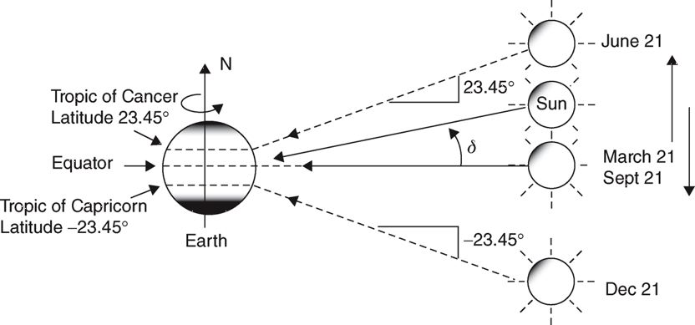
Solar Declination
FIGURE 4.6
Masters, Gilbert M. Renewable and Efficient Electric Power Systems, 2nd Edition
δ varies between +/- 23.45˚
Assuming a sinusoidal relationship, a 365 day year, and n =81 is the spring equinox,
Notes:
16

Slide 18
The Sun’s Position in the Sky
FIGURE 4.6
Masters, Gilbert M. Renewable and Efficient Electric Power Systems, 2nd Edition
Solar declination
Predict where the sun will be in the sky at any time
Pick the best tilt angles for photovoltaic (PV) panels
Notes:
17

Slide 19
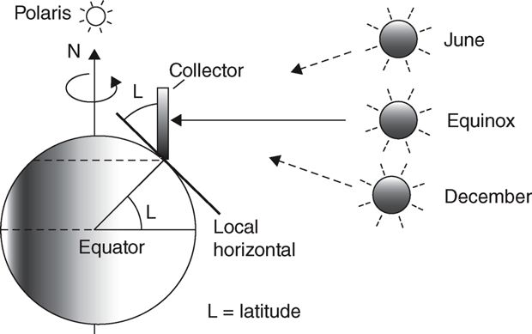
Solar Noon and Collector Tilt
Tilt of 0° is straight up,
Tilt of 90° is perpendicular
Solar noon – sun is directly over the local line of longitude
At solar noon, sun’s rays are ⊥ to the collector’s face
FIGURE 4.8
A south-facing collector tipped up to an angle equal to its latitude is perpendicular to the sun's rays at solar noon during the equinoxes
Masters, Gilbert M. Renewable and Efficient Electric Power Systems, 2d Ed. Wiley-Blackwell
Notes:
18

Slide 20
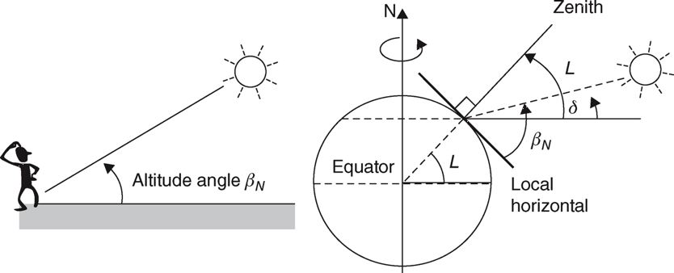
Altitude Angle β_{N} at Solar Noon
FIGURE 4.9 The altitude angle of the sun at solar noon
Masters, Gilbert M. Renewable and Efficient Electric Power Systems, 2nd Edition. Wiley-Blackwell
Altitude angle at solar noon β_{N} – angle between the sun and the local horizon
Zenith – perpendicular axis at a site
Notes:
19

Slide 21
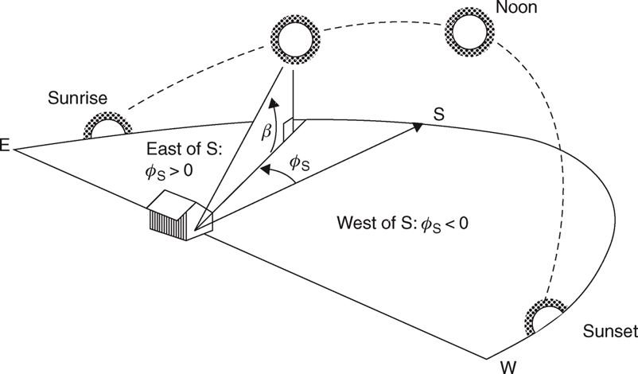
Solar Position at Any Time of Day
β
φ_{s}
FIGURE 4.10
Masters, Gilbert M. Renewable and Efficient Electric Power Systems, 2nd Edition. Wiley-Blackwell
The sun's position is described by
Altitude angle
Azimuth angle ϕ_{S}
By convention, ϕ_{S} is considered ‘+’ before solar noon
β
φ_{s}
Notes:
20

Slide 22
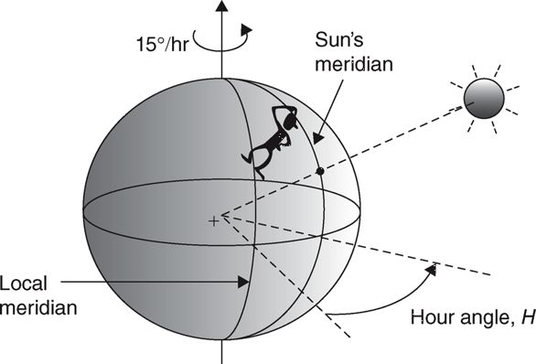
Altitude Angle and Azimuth Angle
Hour angle H – earth rotation ^{(degs)} until sun is overhead
Earth rotates at 15˚/hr….
At 11 AM solar time, H = +15˚ (the earth needs to rotate 1 more hour)
At 2 PM solar time, H = -30˚
Notes:
21

Slide 23
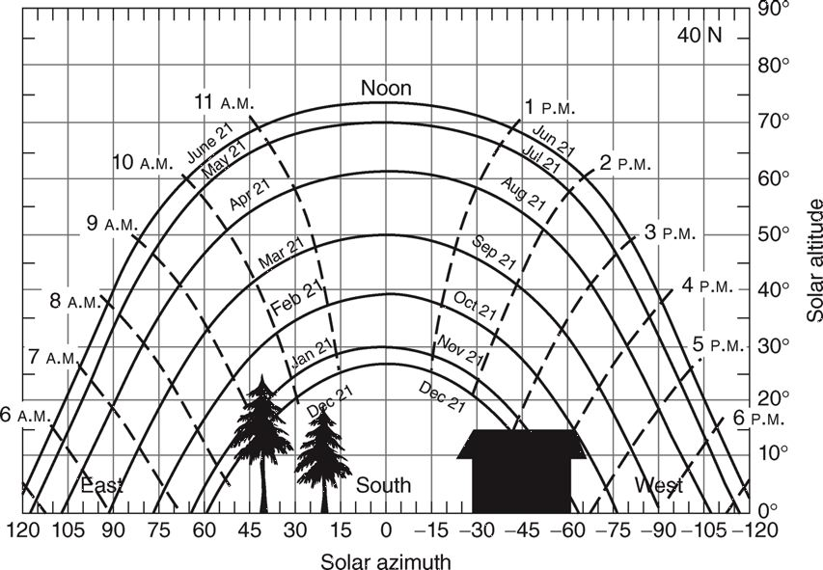
Sun Path Diagrams for Shading Analysis
Shading PV panel (or portion) greatly reduces energy output
Able to model the sun’s position at all times → Site the PV array Using Sun Path Diagram
Sketch azimuth & altitude angles of trees, buildings, other obstructions
Sections Covered on the Sun Path Diagram indicate times when the site will be shaded
Notes:
22

Slide 24
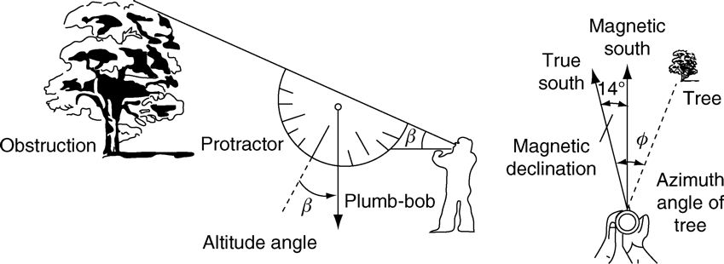
Sun Path Diagrams for Shading Analysis
40 N
Notes:
23

Slide 25
Sun Path Diagram for Shading Analysis
Trees to the southeast, small building to the southwest
Can estimate the amount of energy lost to shading
FIGURE 4.14 A sun path diagram with superimposed obstructions makes it easy to estimate periods of shading at a site
Masters, Gilbert M. Renewable and Efficient Electric Power Systems, 2nd Edition. Wiley-Blackwell
Notes:
24

Slide 26
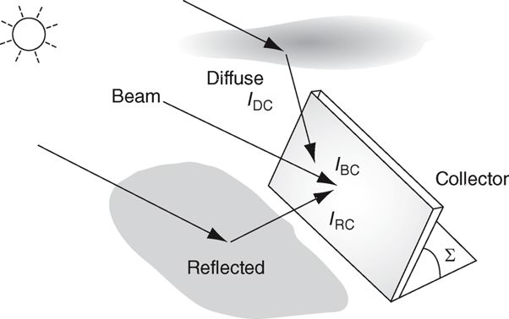
Clear Sky Direct-Beam Radiation
Direct beam radiation I_{BC} – passes in a straight line through the atmosphere to the receiver
Diffuse radiation I_{DC} – scattered by molecules in the atmosphere
Reflected radiation I_{RC} – bounced off a surface near the reflector
Notes:
25

Slide 27
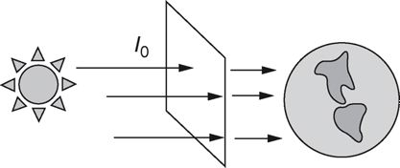
Extraterrestrial Solar Insolation I₀
Starting point for clear sky radiation calculations
I₀ passes perpendicularly through an imaginary surface outside of the earth’s atmosphere
Ignoring sunspots, I₀ can be written as
SC = solar constant = 1.377 kW/m²
n = day number
In 1 year, < .5 I₀ reaches earth’s surface as a direct beam
I₀ varies only due to eccentricity in the earth's orbit
Notes:
26

Slide 28
Attenuation of Incoming Radiation
I_{B} = portion of the radiation that reaches earth’s surface
A = apparent extraterrestrial flux
k = optical depth
m = air mass ratio from Eqn 4.21
The A and k values are location dependent, varying with values such as dust and water vapor content
Notes:
27

Slide 29
Calculating Air Mass Ratio M
At any point in time, the air mass ratio (m) depends upon the sun’s altitude angle, δ
Example: For Urbana L = 40.1° N, on Spring Equinox δ = 0, say H = +15 (one hour before local noon)

Slide 30
Solar Insolation on a Collecting Surface
Direct-beam radiation is just a function of the angle between the sun and the collecting surface (i.e., the incident angle θ):
Diffuse radiation is assumed to be coming from essentially all directions to the angle doesn’t matter; it is typically between 6% and 14% of the direct value.
Reflected radiation comes from a nearby surface, and depends on the surface reflectance, ρ, ranging down from 0.8 for clean snow to 0.1 for a shingle roof.
Notes:
29

Slide 31
Tracking Systems
Most residential solar PV systems have a fixed mount, but sometimes tracking systems are co$t effective
Tracking systems are either
single axis (usually with a rotating polar mount [parallel to earth’s axis of rotation), or
two axis (horizontal [altitude, up-down] and vertical [azimuth, east-west]
Tracking systems add cost & maintenance needs
Notes:
30

Slide 32
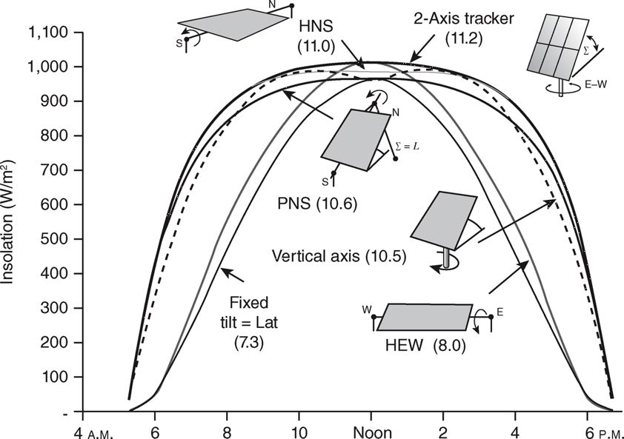
Tracking System Performance
FIGURE 4.30 Comparing clear-sky insolation striking various trackers and fixed and fixed-tilt collector on May 21, latitude 33.7° (Atlanta). Numbers in parentheses are kWh/m²/d
Masters, Gilbert M. Renewable and Efficient Electric Power Systems, 2nd Edition. Wiley-Blackwell
Notes:
31

Slide 33
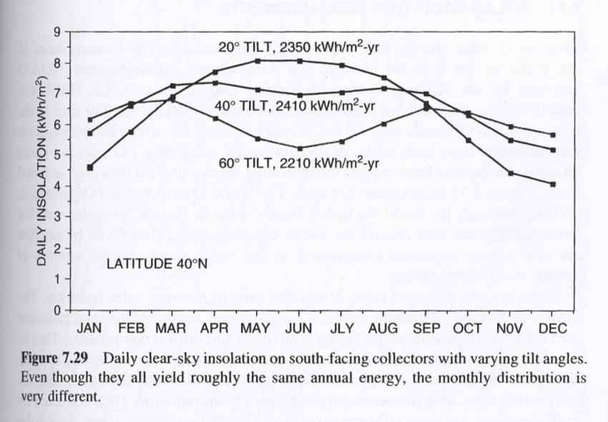
Monthly and Annual Insolation
For a fixed system the total annual output is somewhat insensitive to the tilt angle, but there is a substantial variation in when the most energy is generated
Peak insolation is usually considered 1 kW/m²
Which is known as "One Sun.“
Insolation units: kWh/m² per day, which is equivalent to hours per day of peak insolation
Notes:
32

Slide 34
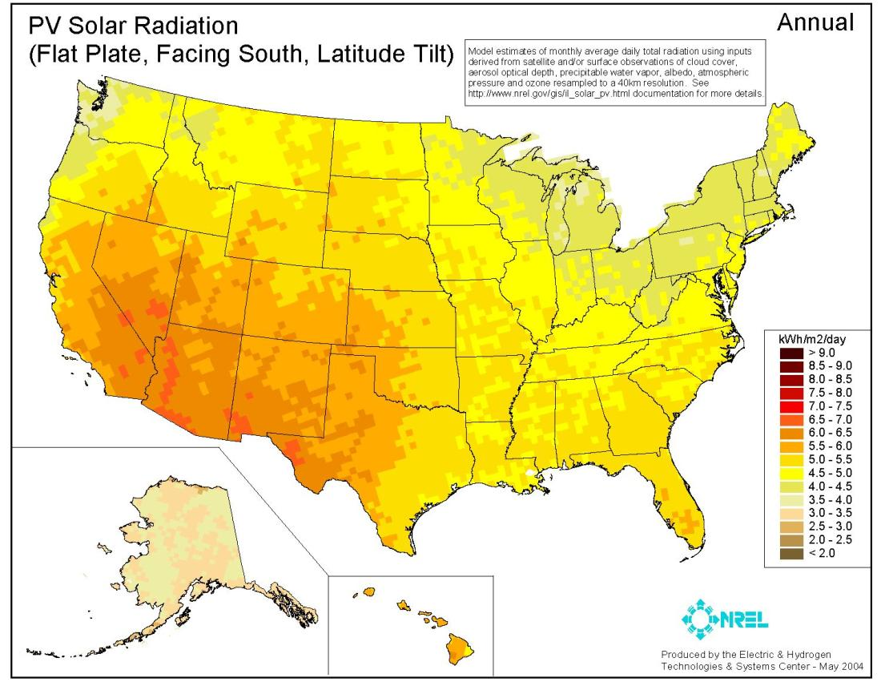
US Annual Insolation
Notes:
33

Slide 35
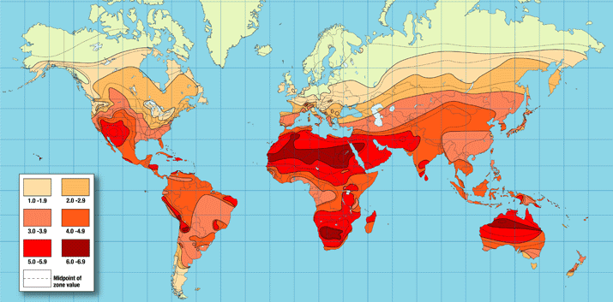
Worldwide Annual Insolation
In 2013 worldwide PV capacity was about 139 GW; countries with most: Germany (36 GW), China (19 GW), Italy (18 GW), Japan (14 GW), US (12 GW), Spain (5 GW)
Source: http://www.iea-pvps.org/
Notes:
34

Slide 36
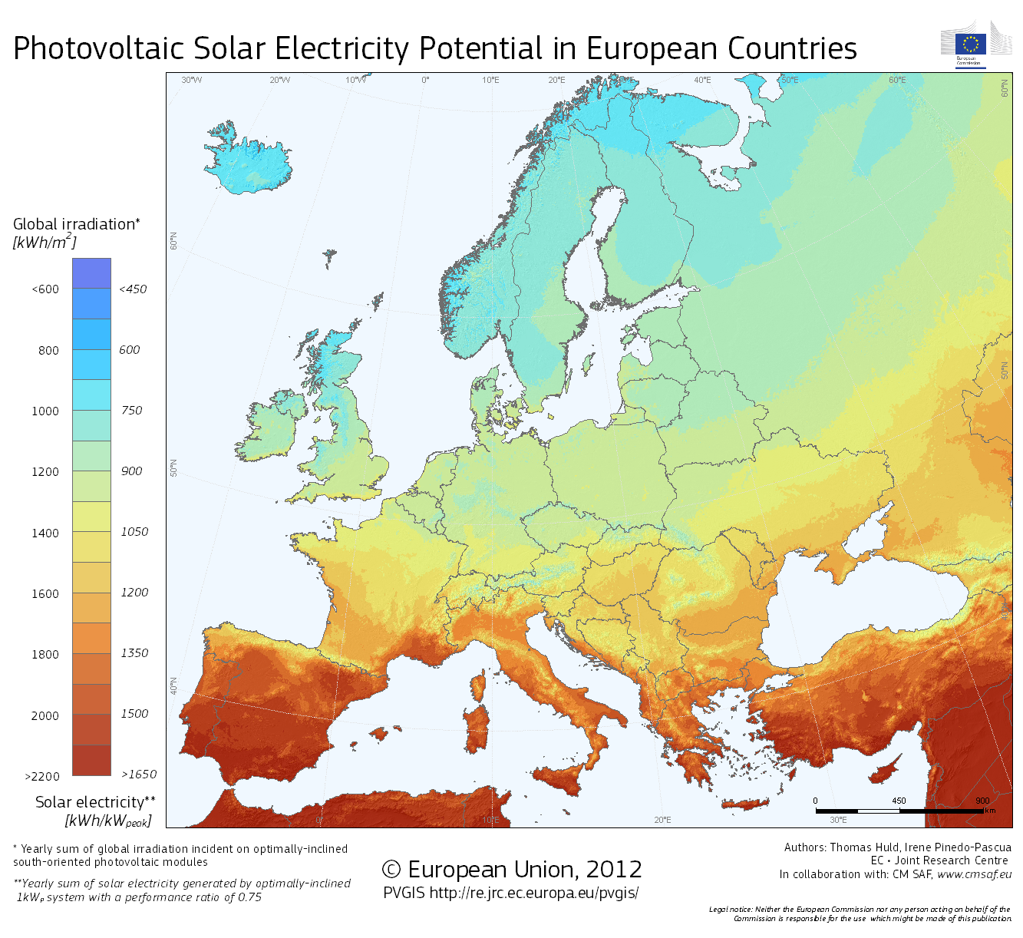
Insolation Potential: Europe
Units can also be given in total kWh/m² for a year (just daily value times 365, 1200 is an average of 3.3 hours per day)
Source http://re.jrc.ec.europa.eu/pvgis/cmaps/eur.htm

Slide 37
IL Insolation Data (Avg kWh/m² per day)
“Evaluation of the Potential for Photovoltaic Power Generation in Illinois” by Angus Rockett, 2006

Slide 38
Solar Thermal
Passive solar is, of course, widely used for lighting and heating
Worldwide low temperature solar energy collectors are widely used for heating water and sometimes air
Higher temperature systems are used for cooking
While certainly an extremely important use of solar energy, solar thermal, without conversion to electrical, is really outside the scope of this class

Slide 39
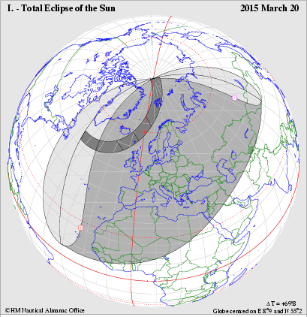
Solar PV and Eclipses
On Friday (March 20, 2015) a partial solar eclipse will occur in the region shown in image
Installed PV in Europe is about 90 GW, and eclipse may reduce the amount by 30 GW (assuming clear skies)
Reduction will not be sudden, and this is certainly a planned event; still the generation impact could be quite large
Source: https://www.entsoe.eu/Documents/Publications/SOC/150219_Solar_Eclipse_Impact_Analysis_Final.pdf

Slide 40
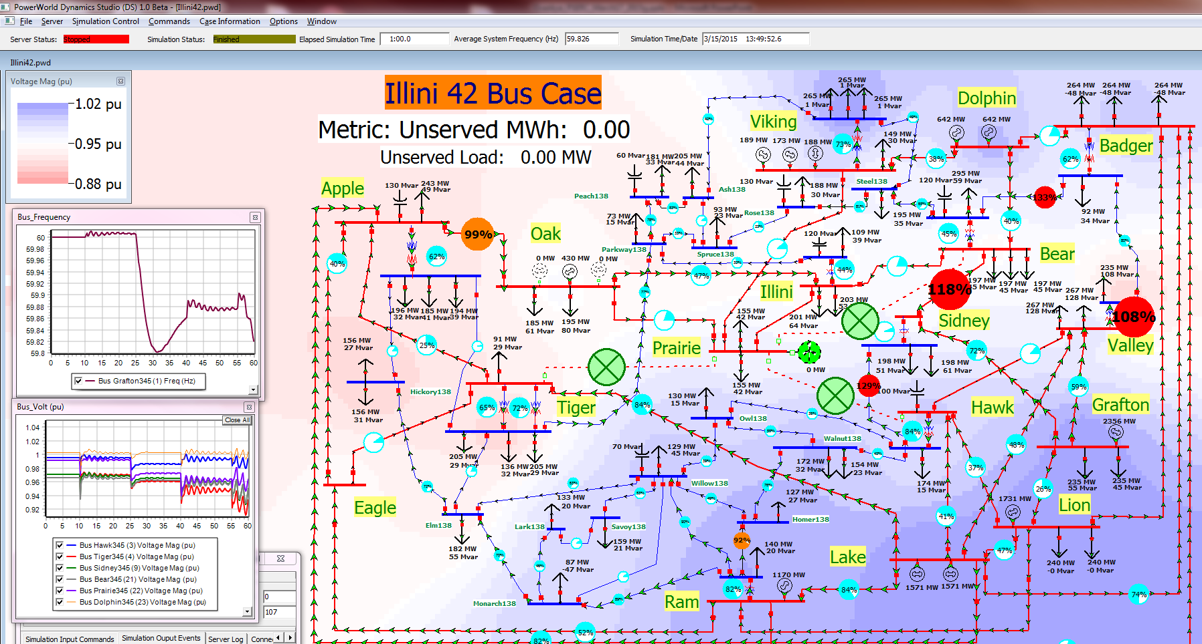
Power System Dynamics Demo
You can download the case at software at http://publish.illinois.edu/smartergrid/Power-Dynamics-Scenarios/

